Slide 1
Ecommerce toy Store Web-Application
By Ayaan Amin Shaikh
Roll No – 25
Seat No -

Slide 2
INTRODUCTION
Toy Heaven Is an Innovative Ecommerce Platform dedicated to bringing joy to children and parents alike by offering a wide variety of high quality, safe and educational toys. Our user friendly website ensures a seamless shopping experience making it easy for customers to find and purchase the perfect toy for kids of all age groups.
Toy Heaven, your one-stop destination for all things playful and fun!
It aims to offer a wide selection of high-quality toys that cater to various age groups and interests, ensuring that customers can easily find and purchase the perfect toys for their children.

Slide 3






TOOLS & TECHNOLOGIES

Slide 4
XAMPP
XAMPP's user-friendly interface allows users to start, stop, or configure the integrated web server, database server, and scripting language interpreters with ease. It's a valuable tool for developing and testing websites, content management systems, e-commerce platforms, and a wide range of web-based applications locally, without the need for an internet connection or an external server. Moreover, XAMPP is not limited to just PHP; it supports multiple programming languages and can be extended with additional components and plugins, making it a comprehensive local development environment for web projects.

Slide 5
PHP
PHP, which stands for "Hypertext Preprocessor," is a widely-used, open-source, server-side scripting language designed for web development. What sets PHP apart is its ability to embed directly within HTML, enabling the creation of dynamic web pages and web applications. It runs on a web server, processing code and generating HTML content that is sent to a user's web browser, allowing for a seamless mix of dynamic and static content. . Its open-source nature, extensive community support, and compatibility with various databases make it an enduring and valuable technology in the realm of web development.

Slide 6
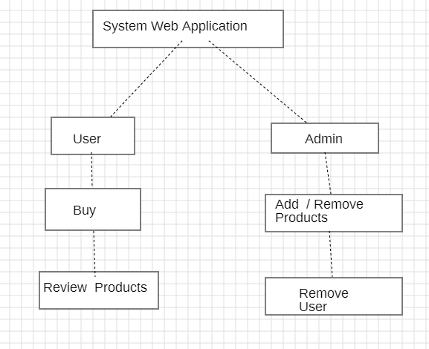
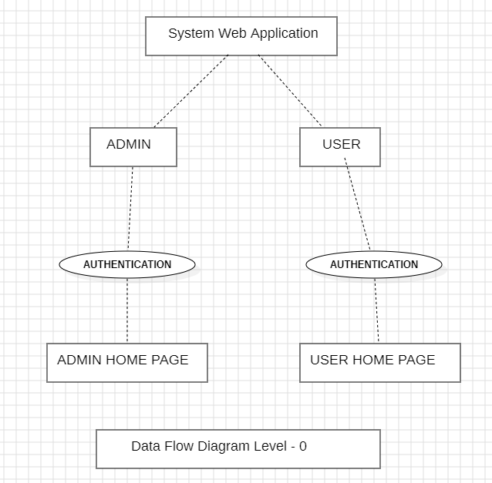
SYSTEM ARCHITECTURE

Slide 7
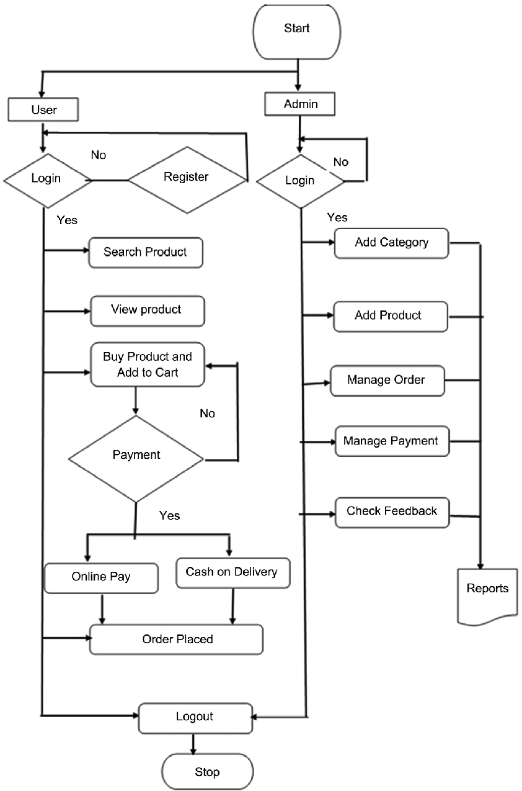
DATA FLOW OF OUR SYSTEM

Slide 8
Advantages of TOY STORE WEB-APPLICATION
Faster Buying And Selling of Products and Easy To Find Products.
Shop Available 24/7.
More each to Customers Connected to Internet.
Low operational cost and better quality of services.
No need of Physical company setup.
Easy to start and manage a business

Slide 9
Disadvantages of TOY STORE WEB-APPLICATION
Unable to examine products personally
Limited reach to customers has everyone is not connected to internet
There is Possibility of payment theft.
Mechanical failure can cause unpredictable effects on the total processes.
Return of products is not possible if its original package is removed.

Slide 10
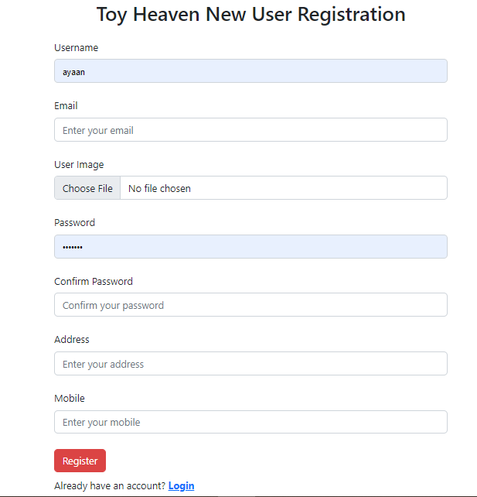
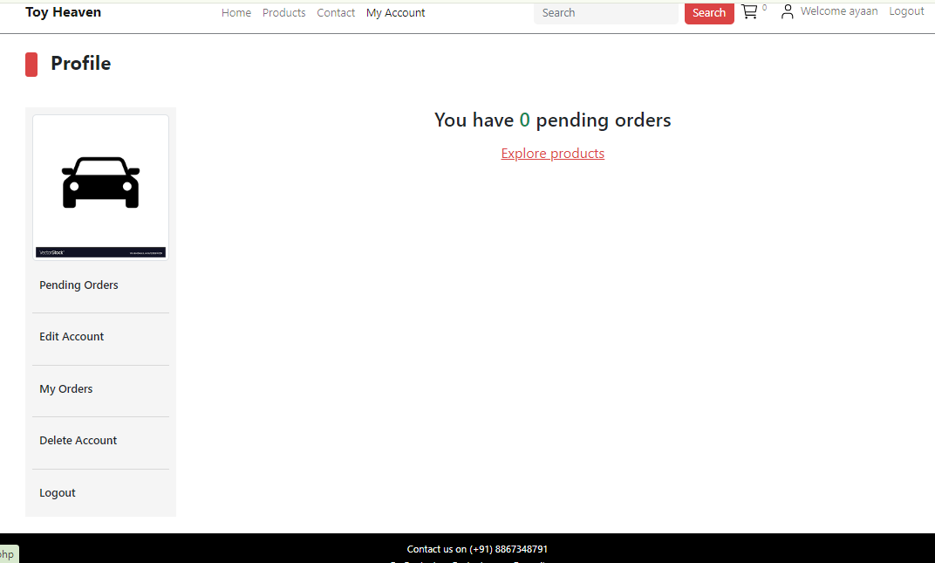
RESULTS

Slide 11
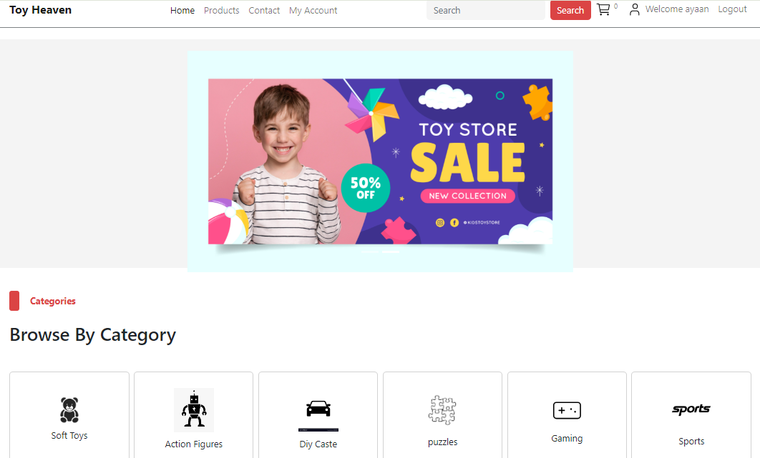

Slide 12
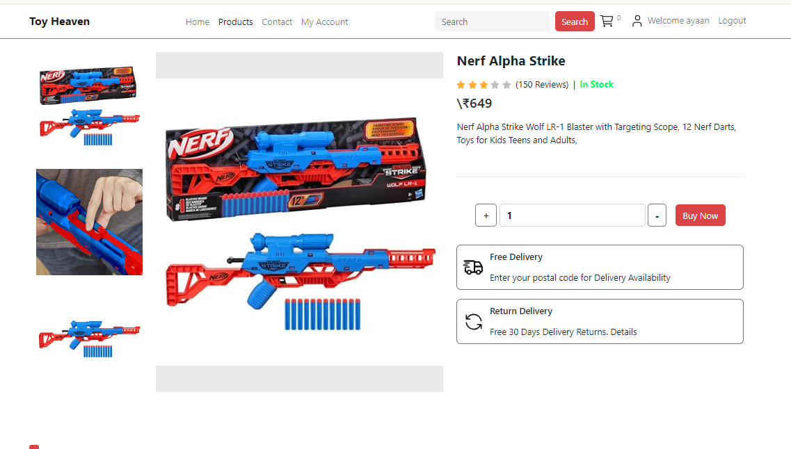

Slide 13
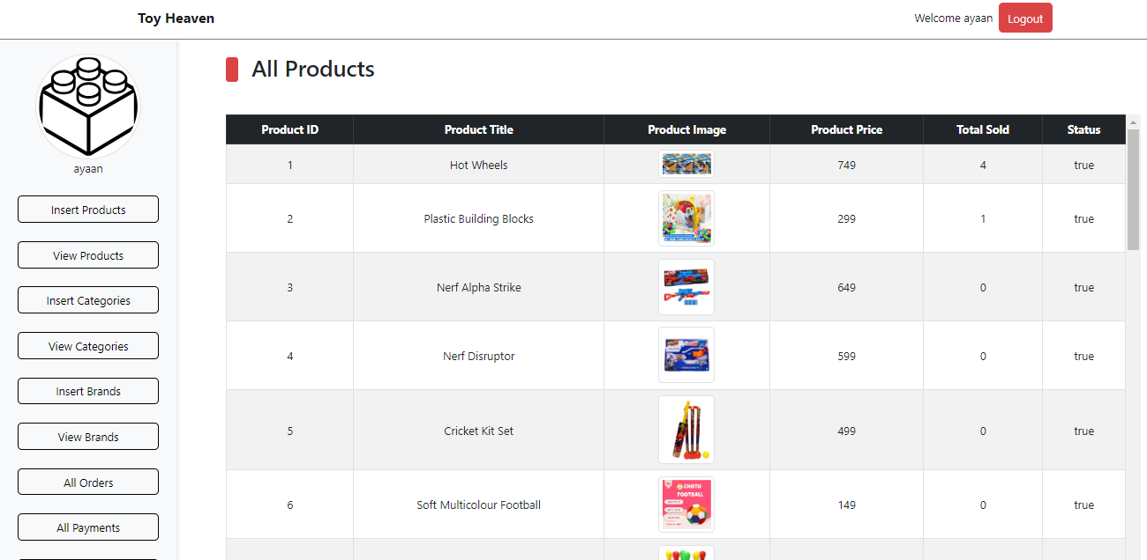

Slide 14
THANK YOU !!

